Slide 1

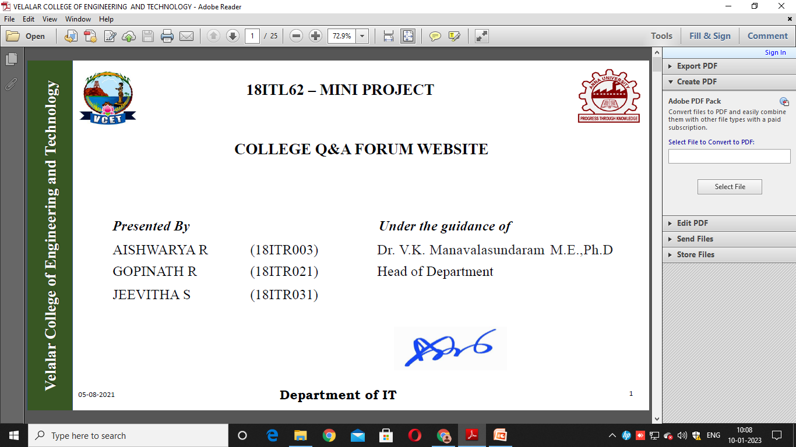
Velalar College of Engineering and Technology
21ITL62- MINI PROJECT
Unveiling Mental Health Insights from Social Media with LSTM and RoBERTa Model
Presented by,
BHUVANESHVAR P M 22ITR017
DHARSHINI B 22ITR010
DHAYALAN M 22ITR019
KAVIPRIYA M 22ITR049
BATCH 11
Under the Guidance of
Mr. K. GOPALAKRISHNAN
AP/IT

Slide 2
OBJECTIVE
Velalar College of Engineering and Technology
To develop a system that detects early signs of mental illnesses such as anxiety and depression using social media data.
The system will use deep learning techniques to analyze text and images from social media platforms, helping healthcare professionals make more accurate and timely diagnoses.

Slide 3
ABSTRACT
Velalar College of Engineering and Technology
Million people around the world, 1 in 8 people, were living with a mental disorder. The pandemic causes significant increases in the number of mental illnesses especially anxiety and depression .Mental illness is a state that affects the day-to-day life of a person, affecting the person’s behavior, feelings, thinking, and mood . There was no medical test to easily detect mental illness. Detection can be done only by blood test (mimic mental health) or imaging scan (physical or structural issues in the brain), which takes more time for diagnosis. Using user's image and text, he/she has uploaded on the social media platform, by employing algorithms CNN-LSTM for picture and RoBERTa for content we can examine the condition of mental disorder such as depression and anxiety. The system predicts mental illness and helps healthcare professionals understand the model better, build tests and make more accurate diagnoses.

Slide 4
DOMAIN KNOWLEDGE
Velalar College of Engineering and Technology
Mental health is a critical part of overall health, affecting thoughts, emotions, and behavior. Common disorders include depression, anxiety, PTSD, and bipolar disorder.
Uses clinical interviews, DSM-5 criteria, psychological tests. Often limited by stigma, accessibility issues, and underreporting.
Social media acts as a source of digital biomarkers—user express emotions and mental states openly. Enables non-invasive, real-time mental health observation.
AI and NLP provide scalable tools for early detection of mental health issues.
LSTM plays a key role in analyzing sequential text data to detect mental health conditions accurately
CNN helps analyze facial expressions from social media images to identify possible mental health concerns.
RoBERTa considers the full context of words in a sentence, making it better at understanding mental health indicators.

Slide 5
LITERATURE SURVEY
Velalar College of Engineering and Technology
Author(s) | Title | Year | Algorithm(s) Used | Result | Merit | Demerit (Gap to Address)
Joseph Aina et al. | A Hybrid Learning-Architecture for Mental Disorder Detection Using Emotion Recognition | 2024 | YOLOv8, ResNet50, ViT, MDNet | 81% accuracy in detecting depression and anxiety | Hybrid model, explainability with Grad-CAM | Relies only on facial features, lacks text-based analysis
M. E. Aragón et al. | Detecting mental disorders in social media through emotional patterns | 2021 | Emotion-based NLP models | Detects anorexia and depression from social media text | Effective in emotional text detection | No multimodal approach, ignores images
A. Karamat et al. | A Hybrid Transformer Architecture for Multiclass Mental Illness Prediction Using Social Media | 2024 | Transformer-based NLP model | Predicts multiple mental illnesses using text | High accuracy for text-based classification | No image analysis, lacks multimodal integration
M. M. Tadesse et al. | Detection of Depression-Related Posts in Reddit Social Media Forum | 2019 | ML with NLP | Classifies depressive vs. non-depressive posts | Uses real-world social media data | Limited dataset, lacks deep learning techniques
D. Ramírez-Cifuentes et al. | Enhanced word embedding variations for detection of mental health issues on social media | 2021 | Word embeddings, NLP models | Improved text-based classification | Diverse linguistic patterns | No image-based analysis, lacks visual context

Slide 6
PROBLEM IDENTIFICATION
Velalar College of Engineering and Technology
Peoples with mental health have difficulty in focusing, remembering things or making decision.
There are many reasons that cause mental health problems, which people themselves may not realize or may find difficult to share with others
It leads to problems in relationships, struggles at work or school.
Traditional diagnosis methods like clinical interviews and medical tests are time-consuming.
Nowadays, people are increasingly focusing on sharing their thoughts through social media comments and posts.

Slide 7
PROPOSED SYSTEM:
Velalar College of Engineering and Technology
Text Analysis with RoBERTa :
Utilizes RoBERTa, fine-tuned for mental health contexts, to extract 768-dimensional semantic and emotional embeddings.
Preprocesses text by tokenizing, removing stop words and punctuation, applying stemming or lemmatization, and standardizing to a maximum of 512 tokens.
Extracts features and passes them through a classification layer to generate probability scores for mental health categories.
Image Analysis with CNN-LSTM (ResNet50):
Employs pre-trained ResNet50, excluding the last layer, for spatial feature extraction, and a bidirectional LSTM with 256 hidden units for temporal analysis.
Preprocesses images by resizing to 48x48 pixels, normalizing, and applying augmentations, then extracts 2048-dimensional features.
Uses LSTM to process features, capturing short- and long-term patterns, which are aggregated to form the final image-based features.

Slide 8
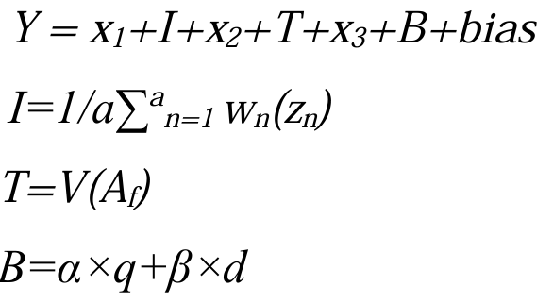
PROPOSED SYSTEM
Velalar College of Engineering and Technology
Risk Score:
feature of image:
feature of text:
Behavior:
q & d = the frequency of post and deletion rate,
x1 & x2 = weight that shows weight of image features and text features,
x3 = the weight for behavioral features,
Zn = CNN extracted features from the image ,
Wn = LSTM processed feature capturing temporal patterns,
V = RoBERTa extracts high level semantic and emotional features from the text,
Af = tokenize text,
α & β = Coefficients for post frequency and deletion rate ,
bias = Bais term.
Depression:
Anxiety:

Slide 9
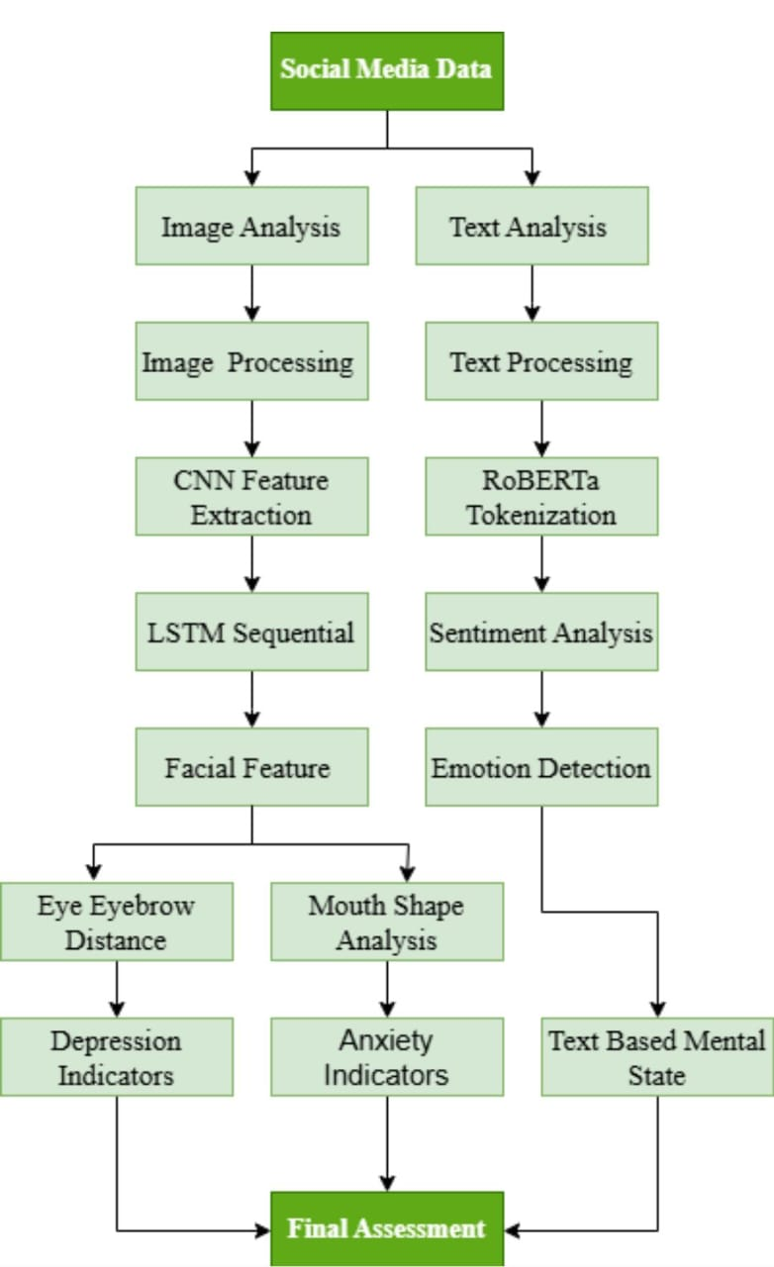
SYSTEM ARCHITECTURE
Velalar College of Engineering and Technology

Slide 10
MODULE: 1.Social Media Data Processing module:
Velalar College of Engineering and Technology
The data is collected from various social media platforms such as Twitter and Reddit, including both text (like posts and comments) and images shared by users.
get_user_input() : gets a text post and image path from the user.
collect_training_data() gathers texts, image paths, and labels (e.g., Depression, Anxiety) into lists for training a multi-modal model.
DATA COLLECTION:
FOR IMAGE : images_dataset
FOR TEXT: Twitter
Reddit_Combi

Slide 11
Velalar College of Engineering and Technology
2.Design of LSTM and RoBERTa Model:
IMAGE:
Uses Bidirectional LSTM for sequential image feature analysis.
Includes Linear layer for classification and Dropout to reduce overfitting.
TEXT:
Utilizes pretrained RoBERTa for text understanding.
Outputs classified results for Depression, Anxiety, Normal, Other.
COMBINED SYSTEM:
RoBERTa handles text analysis.
CNN (e.g., ResNet50) extracts image features.
LSTM classifier classifies image data.
BUILT IN DEVELOPMENT ENVIRONMENT:
Python 3.12.1 virtual environment
Package management with pip 23.2.1 and requirements.txt
Uses libraries like PyTorch, NumPy, Pandas, etc.

Slide 12
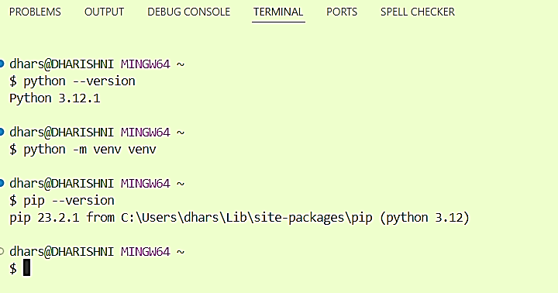
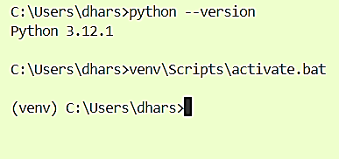
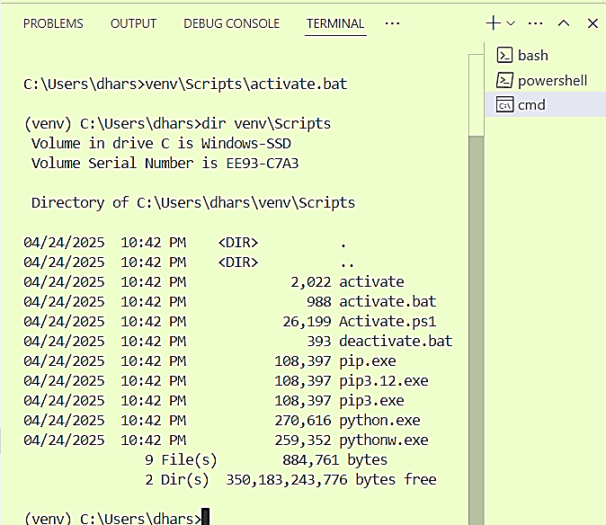
Velalar College of Engineering and Technology

Slide 13
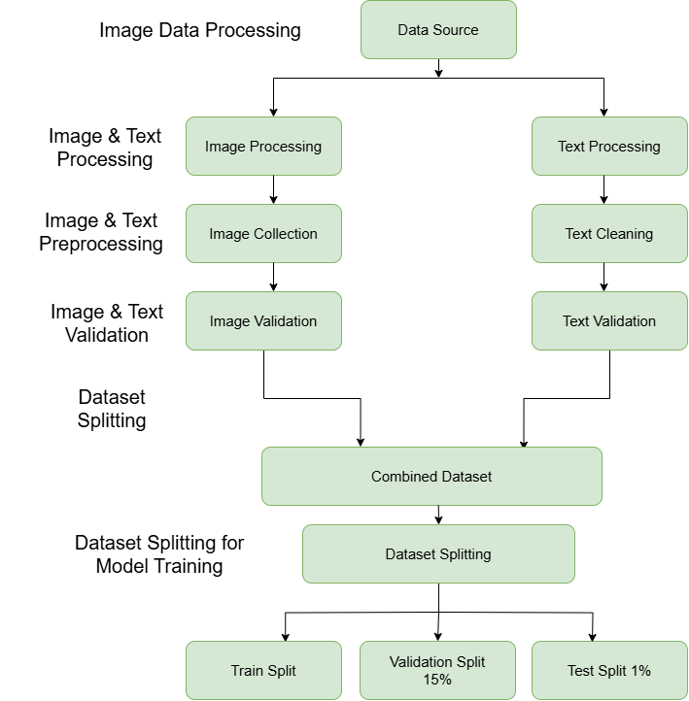
3.Development of LSTM and RoBERTa Model:
Velalar College of Engineering and Technology
IMAGE:
Images are preprocessed (loaded, resized, normalized).
CNN extracts features; LSTM-based classifier predicts class probabilities.
Text Analysis:
Text is tokenized and processed using the pretrained RoBERTa model.
A classifier maps features to mental health category probabilities via Softmax.
Fusion and Classification:
Text and image probabilities are combined using weighted fusion (e.g., 60% text, 40% image).
Final class is predicted based on the highest combined probability.

Slide 14
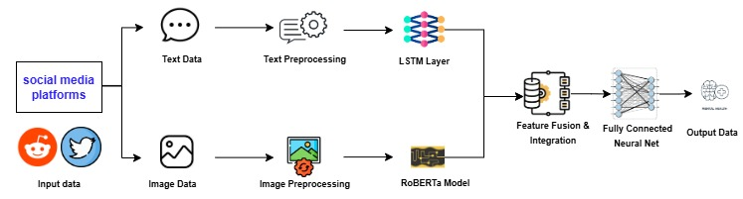
Velalar College of Engineering and Technology
4. Training Models:
1.Dataset Preparation:
Texts: Sentences, documents, or other relevant textual data.
Image Paths: Paths to images used for the task.
Labels: The target classifications or output.
Zipping: Combining text, image, and label data for easier processing.
2. Model Training Loop:
Batches: Each batch processes a subset of the dataset.
Text Analysis: Extracts features and probabilities from the text.
Image Analysis: Extracts features and probabilities from the image.
Logits Calculation: Weighted combination of text (60%) and image (40%) probabilities to form predictions.
3. Loss Calculation & Model Update:
Loss Function: Measures the difference between model predictions and true labels.
Model Update: Optimizes the model based on loss using algorithms like gradient descent.
4. Saving the Model:
Save the Model: Stores the trained model for future use or inference

Slide 15
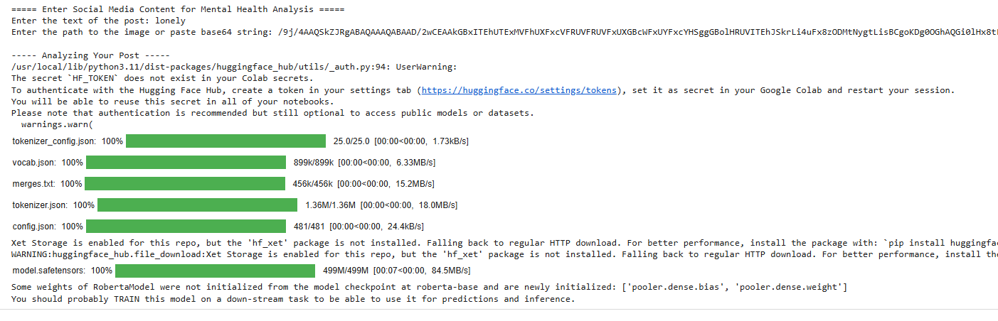
Velalar College of Engineering and Technology
5.Deployment and Testing
Displays the predicted class and the probabilities for each class.
Outputs: Predicted Class and Probabilities for each mental health category.
3. Main Function:
Purpose: Entry point for the system.
"Calls run_demo to initiate the user interaction and predictions.
Analyze Post Function:
Inputs: Text and image data.
Processing: Creates an instance of Mental Health Detector.
Uses classify method to predict the mental health class and probabilities.
Outputs: Predicted Class: The mental health classification.
2. Run Demo Function:
Inputs: User-provided text and image.
Processing: Calls analyze_post to get predictions.

Slide 16
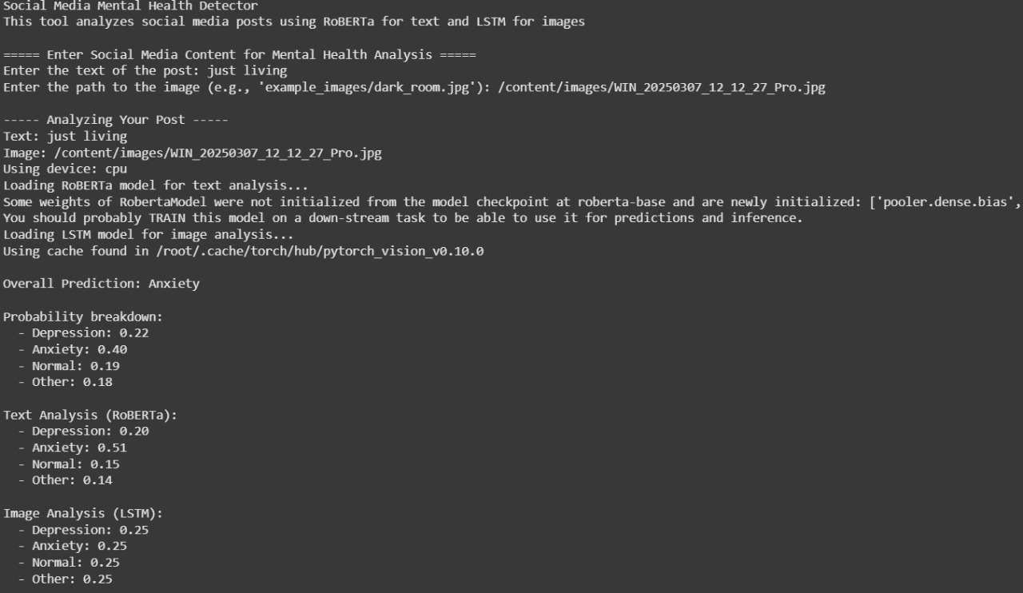
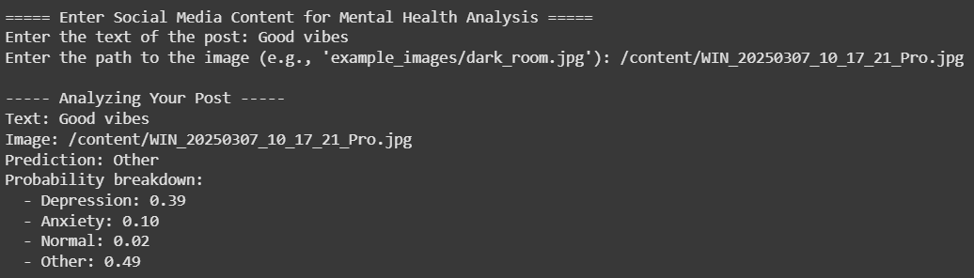
OUTPUT:
Velalar College of Engineering and Technology

Slide 17
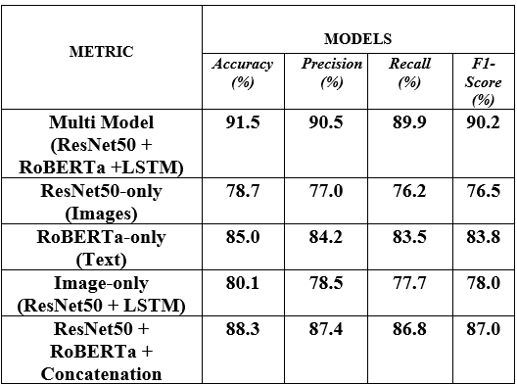
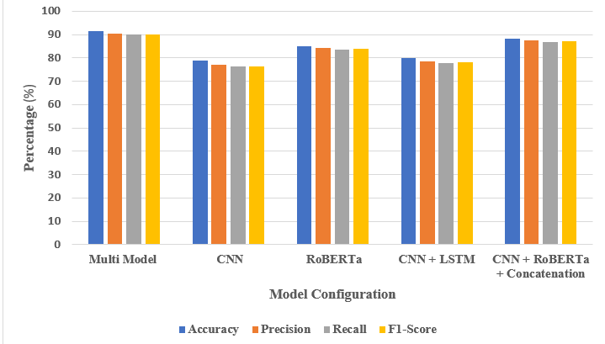
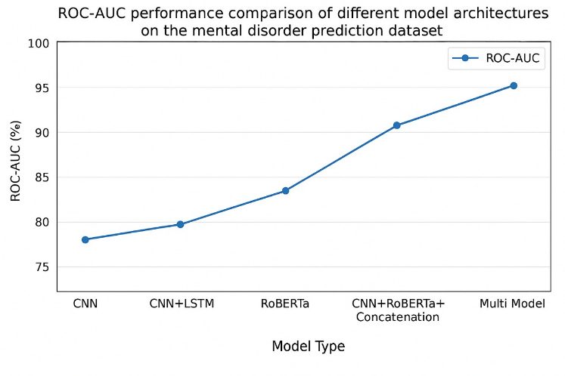
Velalar College of Engineering and Technology
Performance metrics

Slide 18
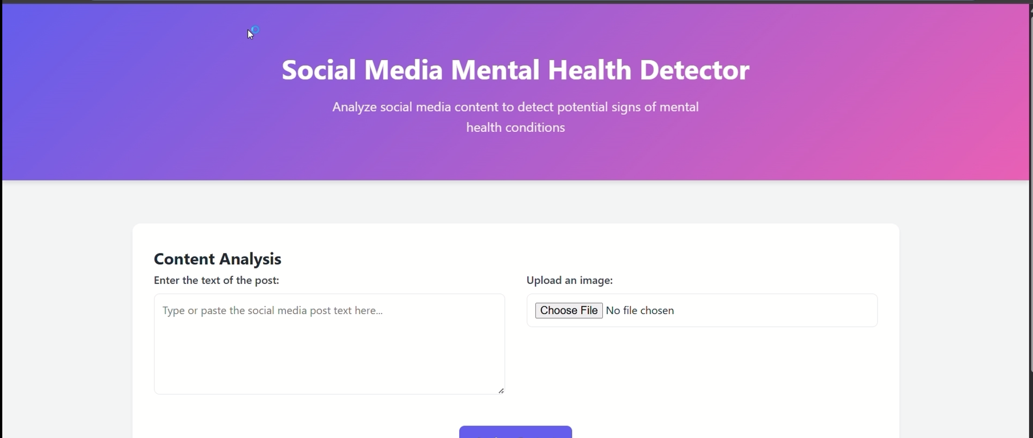
RESULT:
Velalar College of Engineering and Technology
The Mental Health Detection from Social Media module helps identify signs of depression, anxiety, or normal mental state by analyzing text and images shared on social media.
It uses the RoBERTa model to understand emotions in text like comments or posts, and a CNN-LSTM model to study images, focusing on facial expressions and background.
Before analysis, the data is cleaned and prepared. The results from both text and image are combined to make a final prediction.
This helps in detecting mental health issues early in a simple and effective way.

Slide 19
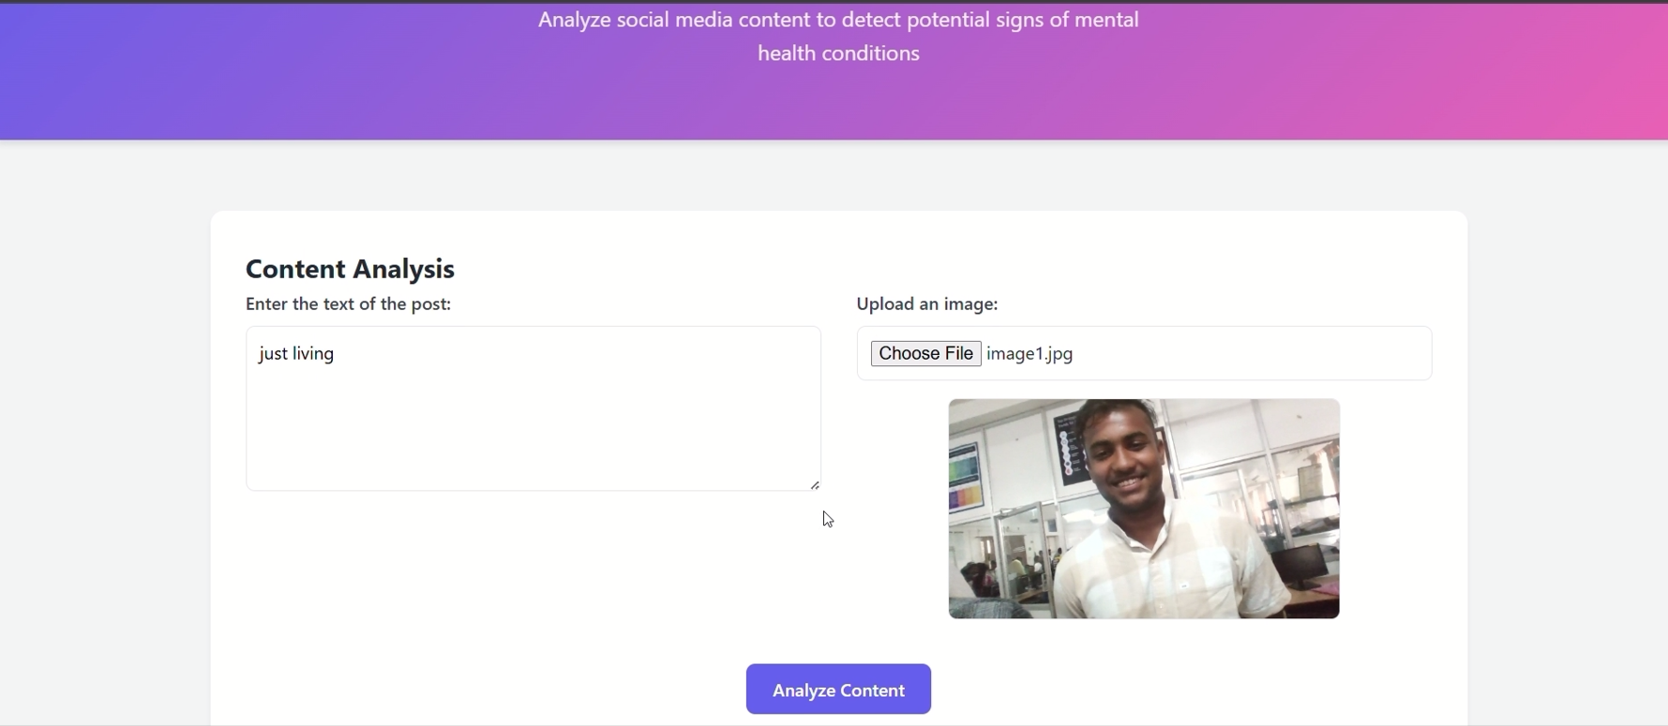
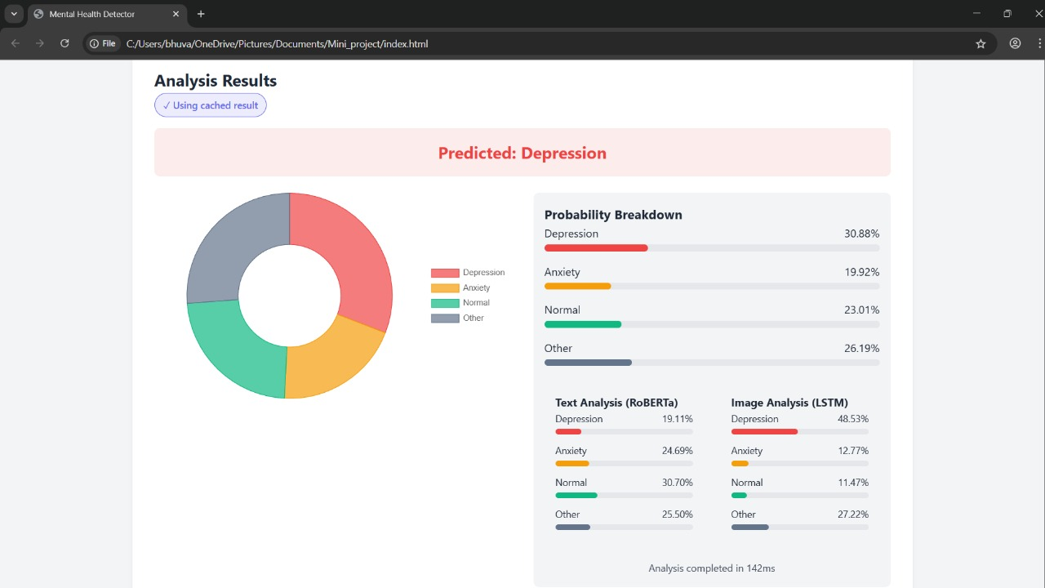
RESULT:
Velalar College of Engineering and Technology

Slide 20
Velalar College of Engineering and Technology
CONCLUSION
This project introduces a new way to detect mental illness early by analyzing social media content using deep learning. It combines CNN-LSTM models to study images and RoBERTa to understand text. By looking at both pictures and words, the system gives a clearer view of a person’s mental state. The main goal is to combine behavioral science and AI to make mental health care more affordable and effective. Early detection through this method can help provide support before problems grow worse. The system will be improved by making the image analysis model (CNN-LSTM) more accurate, tracking user behavior over time using LSTM, and adding real-time analysis through faster processing. In the future, voice and speech analysis will be added to understand emotions better, making this system truly multimodal. It will also support multiple languages by training RoBERTa on different languages, and a mobile app will make it easy for users to access.

Slide 21
Velalar College of Engineering and Technology
REFERENCE:
[1] Ahmed, A., Aziz, S., Toro, C. T., Alzubaidi, M., Irshaidat, S., Serhrn, H. A., Abd-alrazaq, A. A., and Househ, M., “Machine Learning models to detect anxiety and depression through social scoping review,” Computer. Methods Programs Biomed. Update, vol. 2, p. 100066, 2022, Doi: 10.1016/j.cmpbup.2022.100066.
[2] Aragon, M. E., Lopez-Monroy, A. P., Gonzalez, L. C., and Montes-y-Gomez, M., “Detecting mental disorders in social media through emotional patterns: The case anorexia and depression,” IEEE Trans. Affect. Computer., Doi: 10.1109/TAFFC.2021.3075638.
[3] Baltrusaitis, T., Robinson, P., and Morency, L.-P., “OpenFace: An open facial behaviour analysis toolkit,” in Proc. IEEE Winter Conf. Appl. Computer. Vis. (WACV), Lake Placid, NY, USA, Mar. 2016, pp. 1–10, Doi: 10.1109/WACV.2016.7477553.
[4] Boumahdi, F., Amina, M., Nachida, R., and Hamza, H., “A mixed deep learning-based model to early detection of depression,” J. Web Eng., vol. 19, no. 3–4, pp. 429–455, 2020, Doi: 10.13052/jwel1540-9589.19344.
[5] Girard, J. M., Cohn, J. F., Mahoor, M. H., Mavadati, S., and Rosenwald, D. P., “Social Risk and Depression: Evidence from Manual and Automatic Facial Expression Analysis,” in Proc. Int. Conf. Autom. Face Gesture Recognit., 2013, pp. 1–8, Doi: 10.1109/FG.2013.6553748.
[6] He, P., Lei, Z., Zhang, M., Fan, Y., and Li, Y., “Mental health prediction using social media data: A review,” Health Inf. Sci. Syst., vol. 10, no. 1, pp. 1–12, 2022, Doi: 10.1007/s13755-022-00182- 7.
[7] Joshi, D., and Patwardhan, M., “An Analysis of mental health of social media users using unsupervised approach,” Computer. Hum. Behav. Rep., vol. 2, p. 100036, 2020, Doi: 10.1016/j.chbr.2020.100036. 69

Slide 22
Velalar College of Engineering and Technology
[8] Karamat, A., Imran, M., Yaseen, M. U., Bukhsh, R., Aslam, S., Aslam, N., and Ashraf, N., “Hybrid Transformer Architecture for Multiclass Mental Illness Prediction Using Social Media,” IEEE Access, vol. 13, pp. 12148–12171, 2024, Doi: 10.1109/ACCESS.2024.351930.
[9] Kim, ., Lee, J., Park, E., and Han, J., “A deep learning model for detecting mental illness from user content on social media,” Sci. Rep., vol. 10, p. 11846, 2020, Doi: 10.1038/s41598-020-68764-y.
[10] Rawal, D., Gautam, A., and Sharam, P. K., “Machine Learning-Based Detection of Mental Illness Through Social Media: A Comparative Study,” Educ. Adm. Theory Pract., vol. 29, no. 4, pp. 1950– 1953, 2023, Doi: 10.53555/kuey. V 29i4.6290.
[11] Rocher, L., Hendric, J. M., and de Montjoye, Y. A., “Estimating the success of re-identification in incomplete datasets using generative models,” Nat. Commun., vol. 100, p. 3069, Jul. 2019, Doi: 10.1038/s41467-019-10933-3.
[12] Schwartz, G. E., Salt, P., Mandel, M. R., and Klerman, G. L., “Facial Muscle Patterning to Affective Imagery in Depressed and Nondepressed Subjects,” Science, vol. 192, no. 4238, pp. 489– 491, Apr. 1976, Doi: 10.1126/science.1257786.
[13] Tadesse, M. M., Lin, H., Xu, B., and Yang, L., “Detection of Depression-Related Posts in Reddit Social Media Forum,” IEEE Access, vol. 7, pp. 44883–44893, Apr. 2019, Doi: 10.1109/ACCESS.2019.2909180.
[14] Zhang, T., Yang, K., and Ananiadou, S., “Sentiment-guided Transformer with Severity-aware Contrastive Learning for Depression Detection on Social Media,” in Proc. 22nd Workshop Biomed. Natural Lang. Process. BioNLP Shared Tasks, pp. 114–126, 2023, Doi: 10.18653/v1/2023.bionlp- 1.9.
[15] Zhang, Z., Liu, Y., Wang, W., Chen, J., and Yang, X., “A Lightweight network for real-time semantic segmentation of remote sensing images,” Sensors, vol. 24, no. 2, p. 348, 2024.

